Slide 1

Travel assistant Chatbot
BY
Youssif
Hatem
Yara
Amr
Fathy

Slide 2
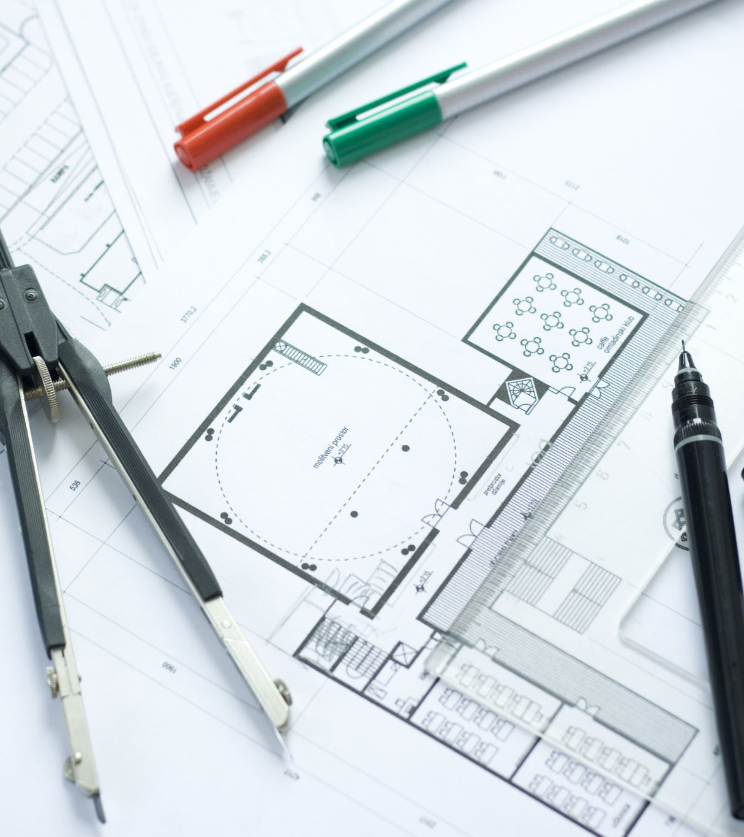
Project overview
Title: Travel Assistant Chatbot (RAG-Based System)AI-powered assistant for regulations & services in Egyptian museums and archaeological sitesBuilt using Retrieval-Augmented Generation (RAG)Supports Arabic languageDelivered via a Streamlit web interface

Slide 3

Problem statement
proposed solution

Slide 4

Data preparation
Pdf from Ministry of Tourism
Chunking
JSON Format

Slide 5

Embedding model and processing
Embedding model(gemini-embedding-001)
Vector database
SQL-lite

Slide 6

System architecture
Multi agent AI system
0.7 RAG (gemini-2.5-flash-lite)
0.3 TF-IDF agent (BM25)
Online Search engine(TAVILY)

Slide 7

Query processing and RAG
Retrieval
Augmented
Generation

Slide 8
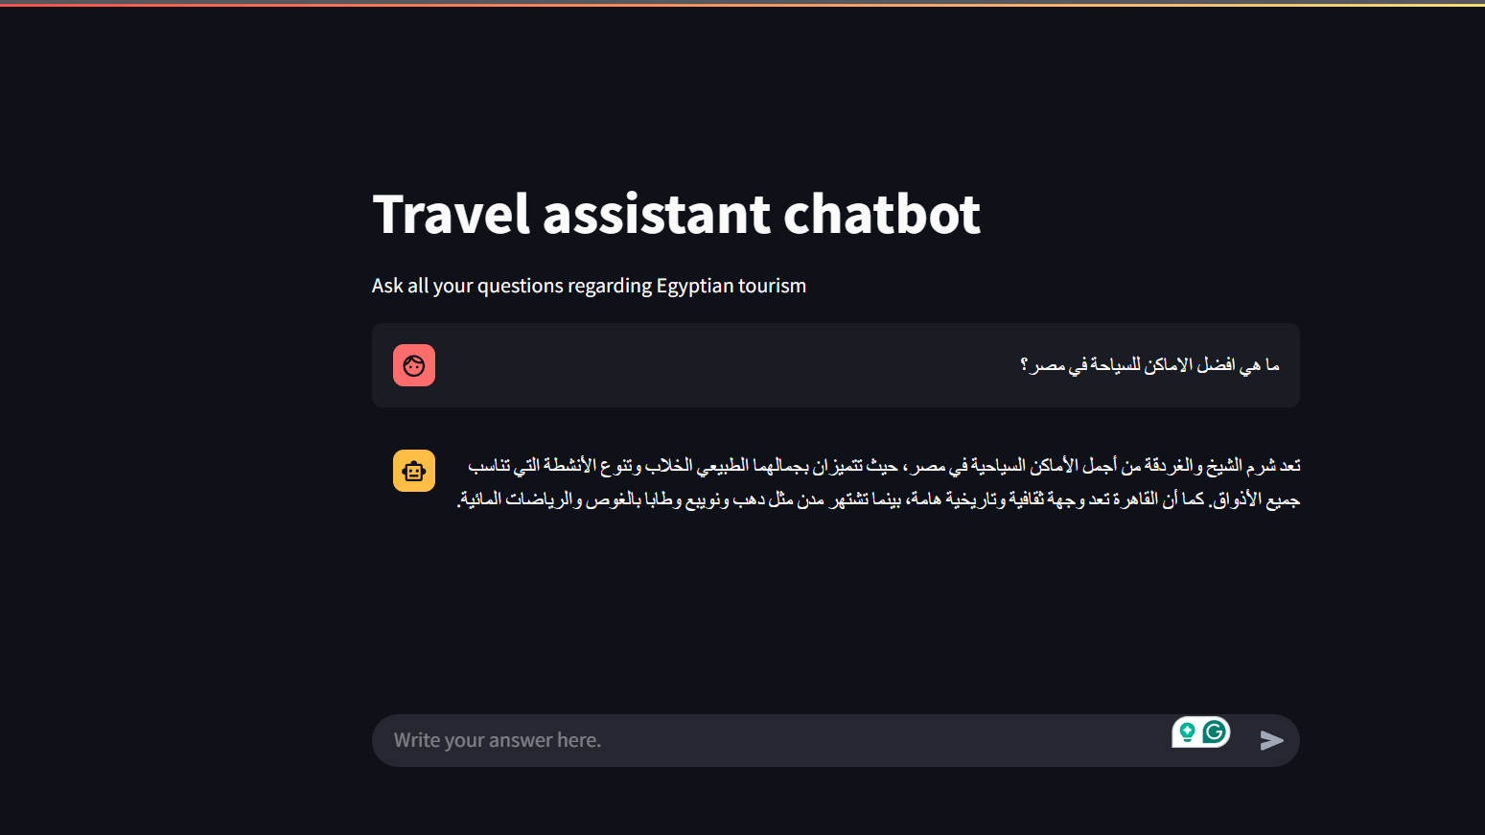
Streamlit User interface and API

Slide 9
Advantage of the project
Asking about fees for events and activities
Understanding rules and constraints for archaeological sites
Supporting employees or visitors with quick regulatory answers
Serving as a foundation for a larger government or tourism AI assistant

Slide 10

Future work

